Slide 1

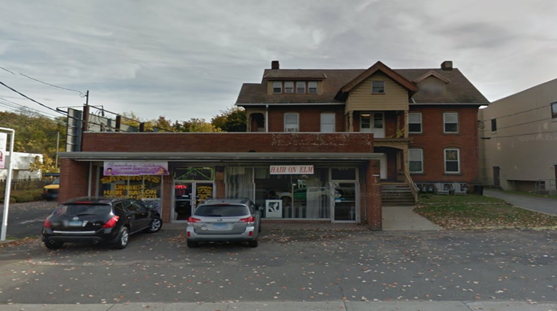
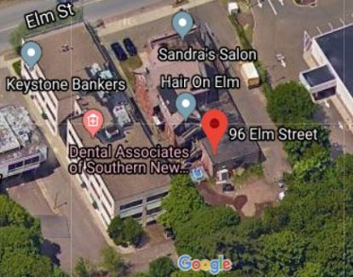
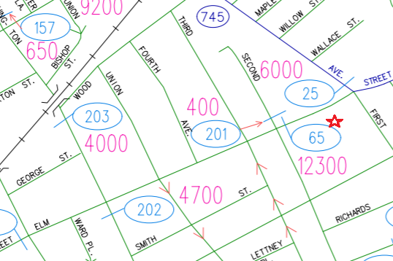
New Haven * Milford * Woodbridge * Branford * Old Saybrook
FOR LEASE
4 OFFICE/ RETAIL/ INDUSTRIAL SPACES
APPROXIMATELY 510 SF - 885 SF AVAILABLE
96 Elm Street, West Haven, CT 06516
RETAIL / OFFICE / INDUSTRIAL SPACE
THREE UNITS & ONE GARAGE
SPACES CAN BE COMBINED
Left Side- Street Front - Unit #1 $2500 per month plus utilities, approx. 510 SF
Unit #2 $4000 per month plus utilities, approx. 880 SF
Unit #3 $3,285 per month plus utilities, approx. 855 SF
Unit #4 Garage $2,000 per month plus utilities, approx. 815 SF
Houlihan Lawrence Wareck D’Ostilio New Haven * Milford * Woodbridge * Branford * Old Saybrook

Slide 2

New Haven * Milford * Woodbridge * Branford * Old Saybrook
Property Information
96 Elm Street, New Haven, CT 06516
510 SF Retail/Office-$2500/mo + util
880 SF Retail/Office- $4000/mo + util
885 SF Warehouse- $3285/mo + util
815 SF Garage- $2000/mo + util
SPACES CAN BE COMBINED
Ken Ginsberg
Broker
(203) 376-6266
ken@kngrealty.com
174 Cherry Street
Milford CT 06460
(203) 701-4848
This document has been prepared by HLWD Commercial for advertising and general information only. HLWD Commercial makes no guarantees, representations or warranties of any kind, expressed or implied, regarding the information including, but not limited to, warranties of content, accuracy and reliability. Any interested party should undertake their own inquiries as to the accuracy of the information. HLWD Commercial excludes unequivocally all inferred or implied terms, conditions and warranties arising out of this document and excludes all liability for loss and damages arising there from. This publication is the copyrighted property of HLWD Commercial and/or its licensor(s). ©2018. All rights reserved.
Houlihan Lawrence Wareck D’Ostilio New Haven * Milford * Woodbridge * Branford * Old Saybrook

Slide 3
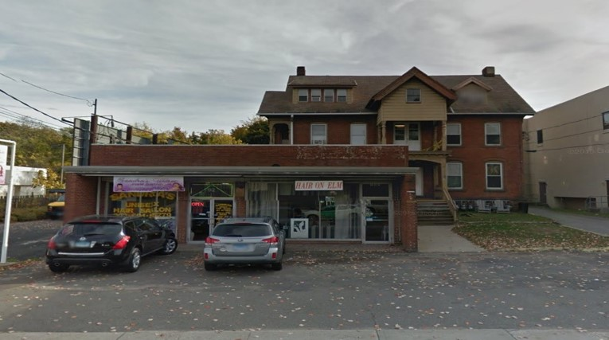

Slide 4
